Slide 1
Big Mountain Resort
Price Model Presentation
Data Intelligence Team
02/11/2023

Slide 2
Problem Identification
BMR has been charging a premium above the average market price.
This pricing strategy doesn’t provide insight on the relative importance of facilities compared to each other and thus hampers investment strategy.
With a recent investment of $1.54M in an additional chair lift, BMR is under pressure to make changes to either cut costs without undermining the ticket price or support an even higher ticket prices.
The goal of this project is to deliver a price model to help set the optimal ticket price based upon facilities BMR has or will acquire.

Slide 3
Recommendation & Key Findings
There’s room for price increase.
Current ticket price = $81
Target price supported by model = $95.87
BMR should close down the least used run.
This won’t impact the ticket price nor revenue, but will reduce the operation cost associated with operating that run.
BMR should increase the vertical drop by adding a run to a point 150 feet lower down and use the additional chair lift just installed to bring skiers back up.
This will increase support for ticket price by $1.99, resulting in $3,474,638 estimated additional revenue.

Slide 4
Model Results & Analysis
Using a seaborn scatterplot, we are able to to conclude that there’s no pattern showing a relationship between state and ticket price.
Using a heatmap and a scatterplot, we’ve identified close correlation between ticket price and resort features such as the vertical drop, snow making area, the number of chairs, fastQuads, runs, etc.
Using the mean absolute error and the train/test sets, we’ve concluded that using average price in the model doesn’t work, as it will set prices off by around $19.
Comparing a linear model with a random forest model, we’ve decided to use the random forest model, as it has a lower cross-validation mean absolute error and exhibits less variability compared to the linear model.

Slide 5
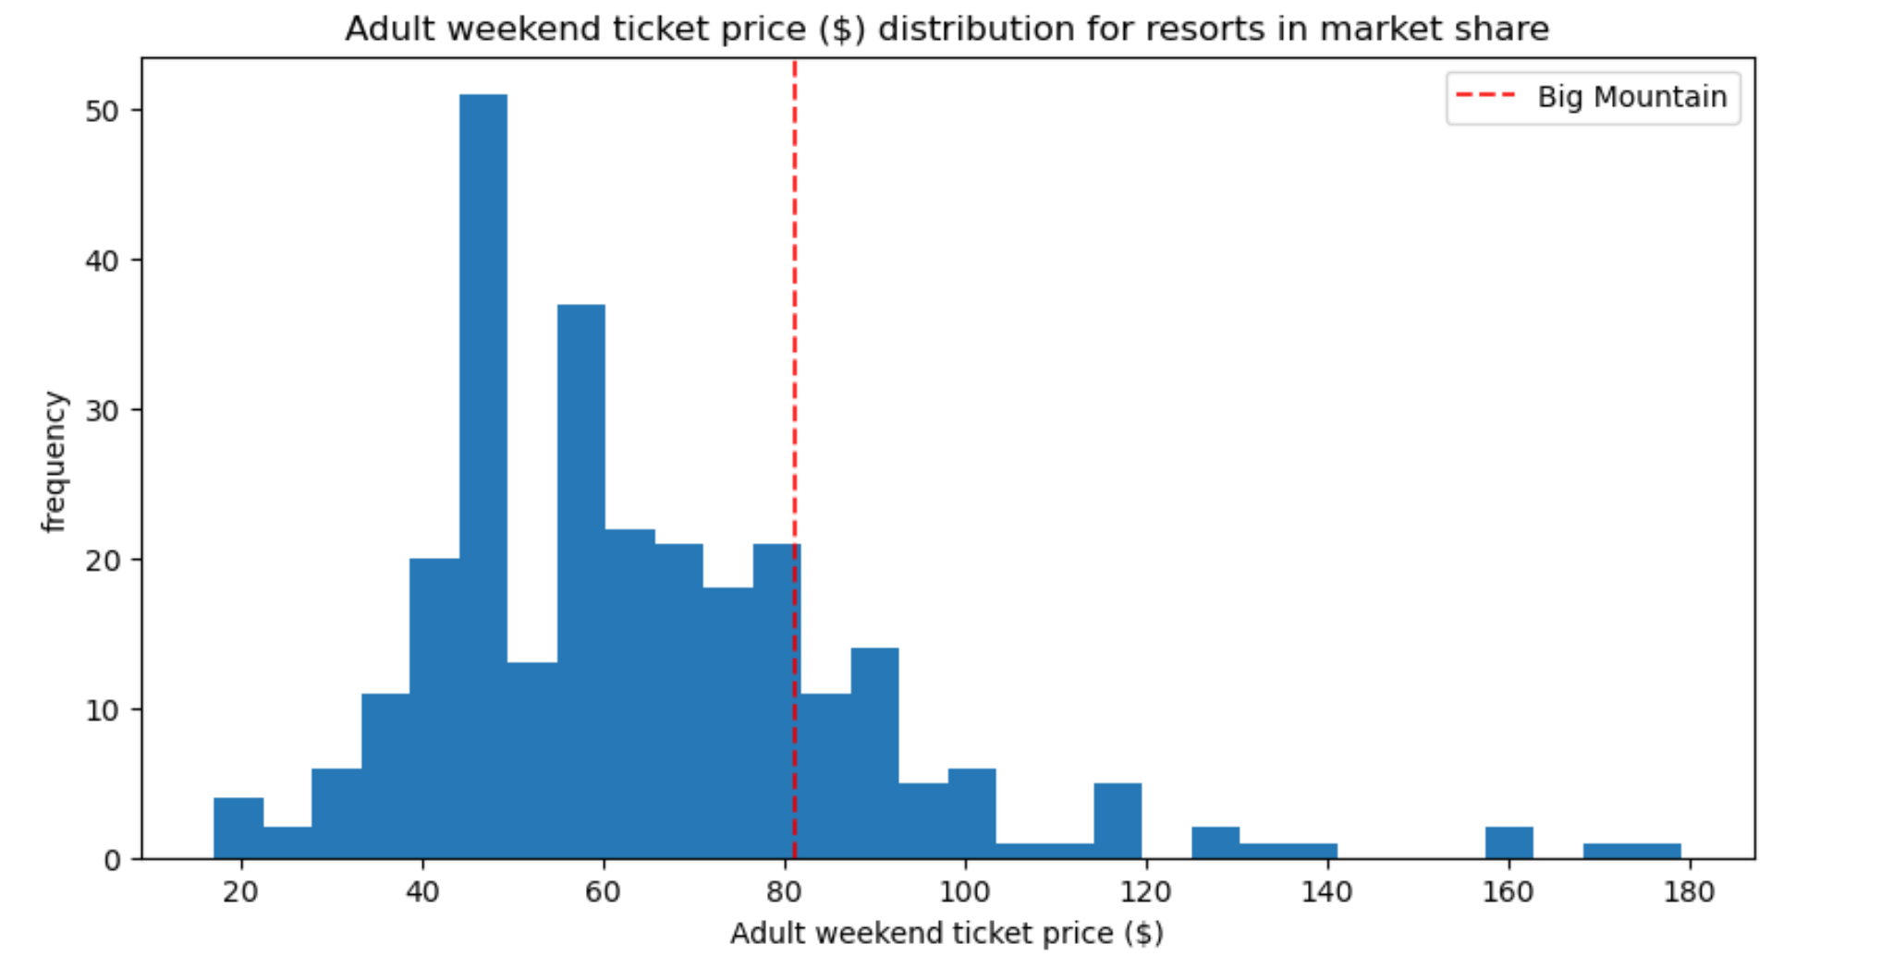
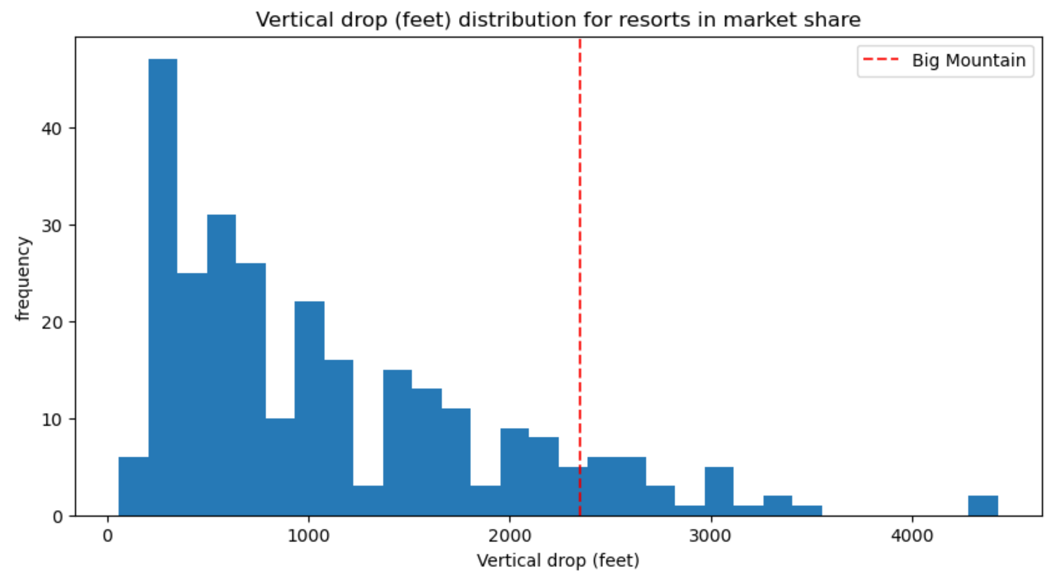
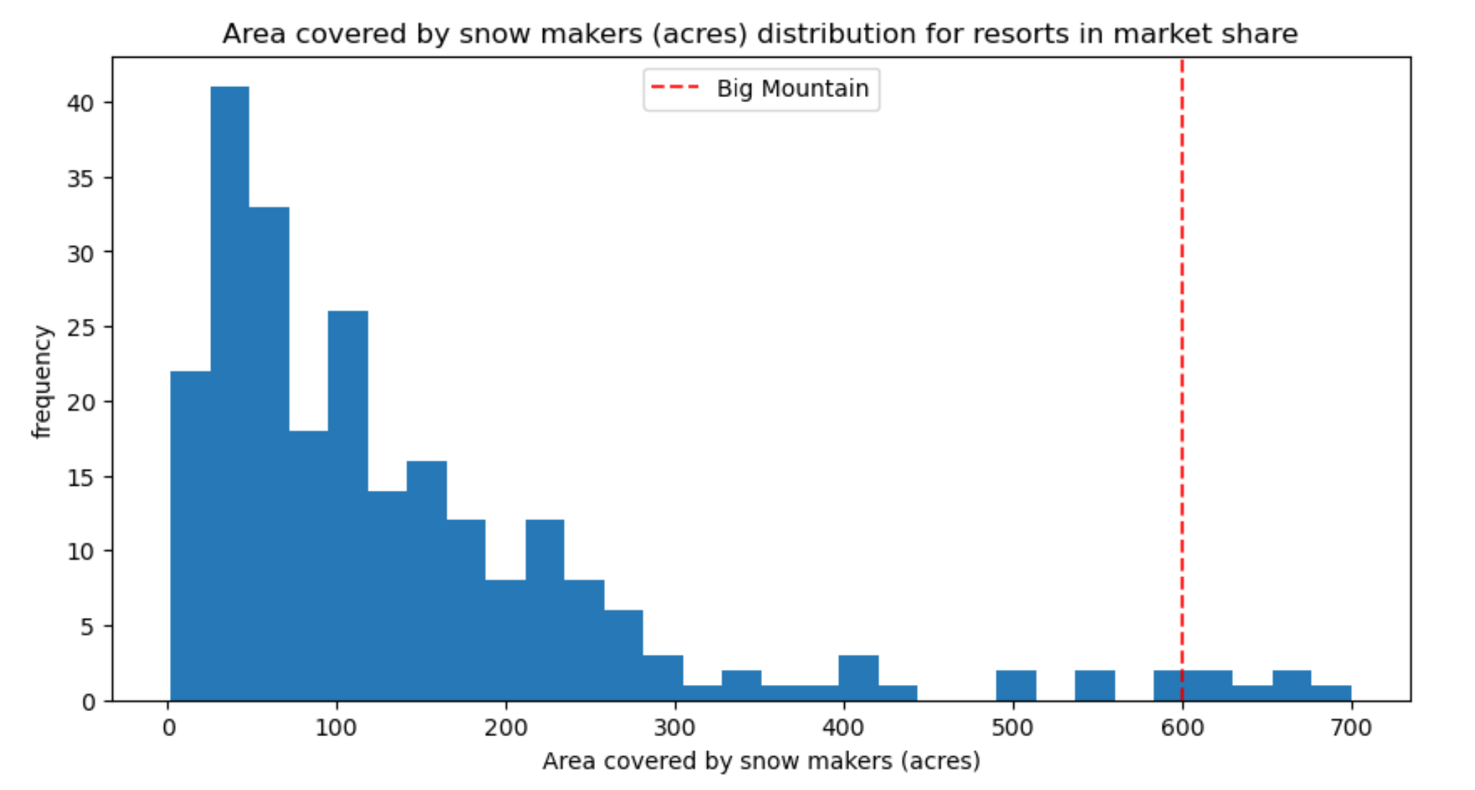
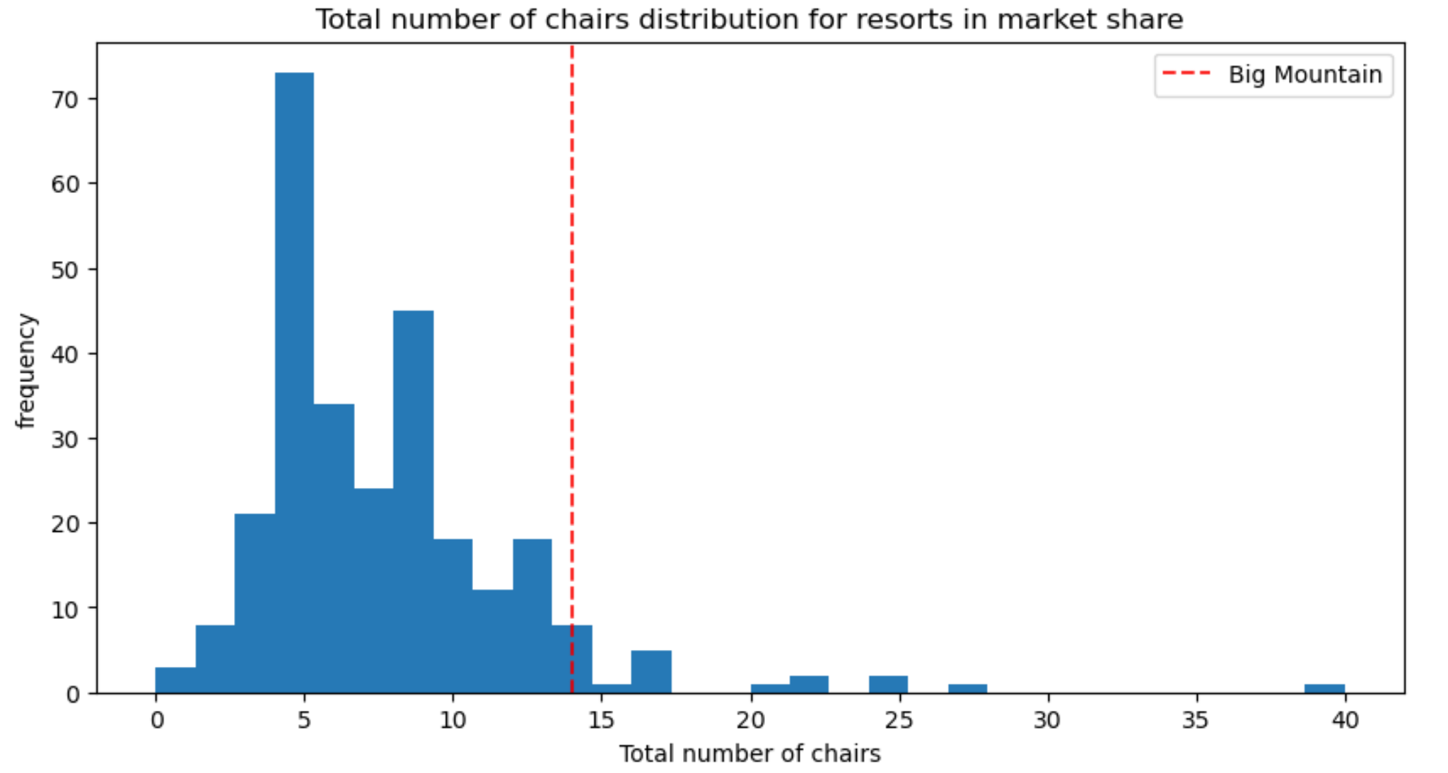
Model Results & Analysis
BMR charges a premium ticket price at $81, which is above average, but not amongst the highest.
BMR is doing well for vertical drop, but there are still quite a few resorts with a greater drop.
BMR is very high up the league table of snowmaking area and number of total chairs.
All these justify future price increases.

Slide 6
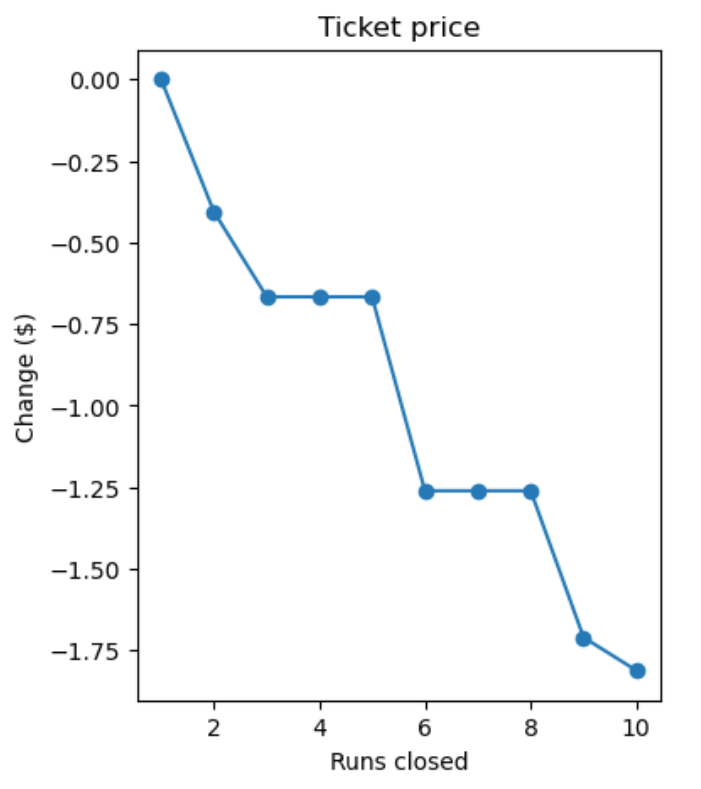
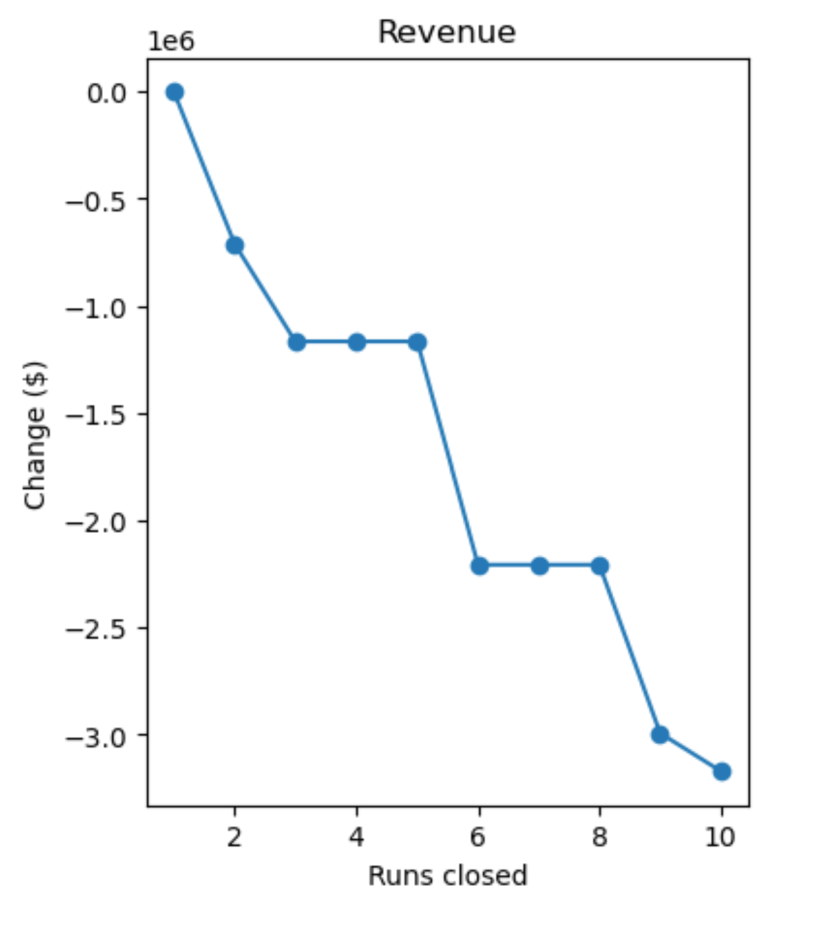
Model Results & Analysis
Scenario Evaluation: Closing up to 10 of the least used runs
Closing one run makes no difference.
Closing 2 and 3 runs successively reduces support for ticket price and so revenue.
If we closes down 3 runs, we should as well close down 4 or 5, as there's no further loss in ticket price.
Increasing the closures down to 6 or more leads to a large drop.

Slide 7
Model Results & Analysis
Scenario Evaluation: Adding a run, increasing the vertical drop by 150 feet, and installing an additional chair lift.
This scenario increases support for ticket price by $1.99. Over the season, this could be expected to amount to $3,474,638 additional revenue.
Adding 2 acres of snow making to this scenario makes no difference in ticket price.
Increasing the longest run by 0.2 miles and guaranteeing its snow coverage by adding 4 acres of snow making capability on top of this scenario doesn’t make any difference either.

Slide 8
Summary & Conclusion
Big Mountain Resort should increase its ticket price referencing the $95.87 target price supported by the model
Big Mountain Resort should implement the following facility operation changes to cut cost and increase revenue.
Close down the least used run immediately while evaluating the timeline to close additional runs.
Increase the vertical drop by adding a run to a point 150 feet lower down & use the new chair lift just installed to bring skiers back up.
Moving forward, we recommend that this price model be used as a reference point for all facilities related decisions including but not limited to new facility investment, facility operation strategy changes, etc.

